Slide 1


Purpose of Presentation
Introduction: My name is Juan Pablo Velasquez, and I've had the privilege of migrating a full-stack application to a cloud-native environment.
Purpose: The main objective of this presentation is to share insights and intricacies of cloud development, making it comprehensible for both technical and nontechnical audiences.
Notes:
Slide 1: Purpose of Presentation
"Hello everyone, I'm Juan Pablo Velasquez. Over the past year, our team embarked on an exciting journey of migrating our full-stack application to a cloud-native environment. Today, I'll be sharing the challenges we faced, the solutions we implemented, and the lessons we learned. The goal is to provide a comprehensive understanding of cloud development, catering to both our tech-savvy and non-technical audience members."

Slide 2
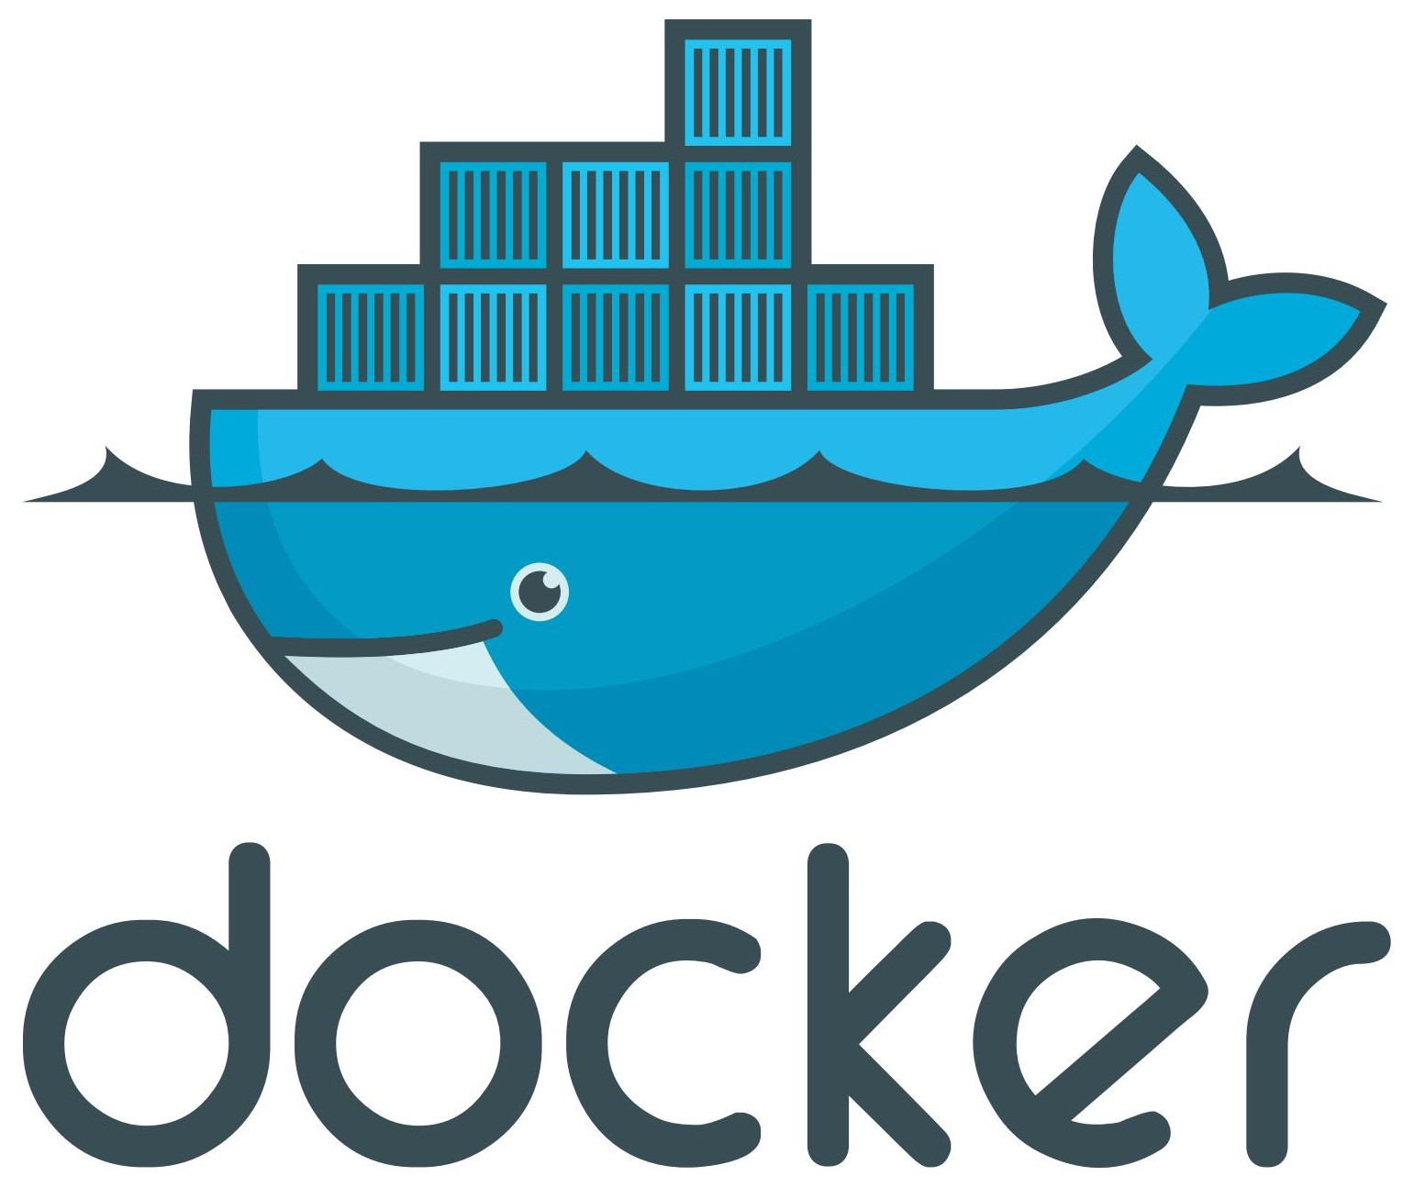
Containerization and Orchestration
Migration Models: Transitioning a full-stack application to the cloud requires a strategic approach. We utilized containerization to package our application and its dependencies.
Containerization Tools: Tools like Docker provide an environment to run applications consistently across various platforms.
Docker Compose Value: Docker Compose facilitates the definition and running of multi-container Docker applications. It streamlines the process, making deployments more efficient.
Suggested image: A screenshot showcasing a Docker Compose file with services defined.
Notes:
Slide 2: Containerization and Orchestration
"When we talk about transitioning to the cloud, it's not just about moving data. It's about ensuring our application runs consistently, irrespective of where it's deployed. This is where 'containerization' comes into play. By packaging our application and its dependencies into 'containers', we achieved this consistency. Docker emerged as an invaluable tool in this process, with Docker Compose further simplifying the orchestration of multiple containers. Here's a snapshot of our Docker Compose file, showcasing the services and their interdependencies."

Slide 3

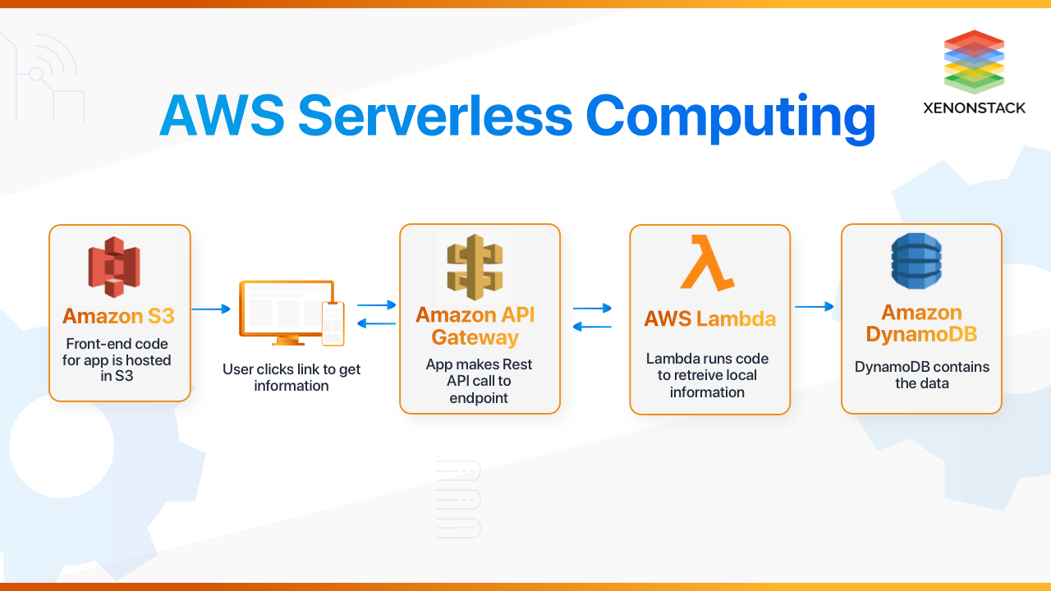
The Serverless Cloud
'Serverless' Defined: Serverless computing allows developers to build and run applications without managing server infrastructure. It offers scalability and cost-effectiveness.
S3 vs. Local Storage: Amazon S3 provides scalable cloud storage, ensuring data availability and security. In contrast, local storage might have limitations in scalability and redundancy.
Serverless API Advantages: Reduced operational complexities, auto-scaling, and cost savings based on actual usage.
Lambda API Logic: AWS Lambda lets you run code without provisioning servers. It scales automatically and integrates with various AWS services.
Frontend-Backend Integration: Connecting the frontend to serverless backend services requires secure API endpoints and proper data flow management.
MongoDB vs. DynamoDB: While MongoDB is a popular NoSQL database, DynamoDB is a managed NoSQL service by AWS, offering seamless scalability and integration with AWS services.
Queries & Scripts: Migration involved transforming MongoDB queries to be compatible with DynamoDB. Scripts were developed to automate data migration and synchronization.
Suggested images: UML diagrams showcasing data flow and architecture.
Notes:
Slide 3: The Serverless Cloud
"The term 'serverless' might sound like a misnomer, but it's essentially about abstracting away the server management aspect. This allows us developers to focus solely on the code, while the infrastructure, scaling, and maintenance are handled by cloud providers. We leveraged Amazon's S3 for storage, which not only provided scalability but also ensured data redundancy. AWS Lambda, on the other hand, allowed us to run backend code in response to events, seamlessly integrating with other AWS services. And when it came to databases, we transitioned from MongoDB to DynamoDB, adapting our queries and automating data migration in the process."

Slide 4
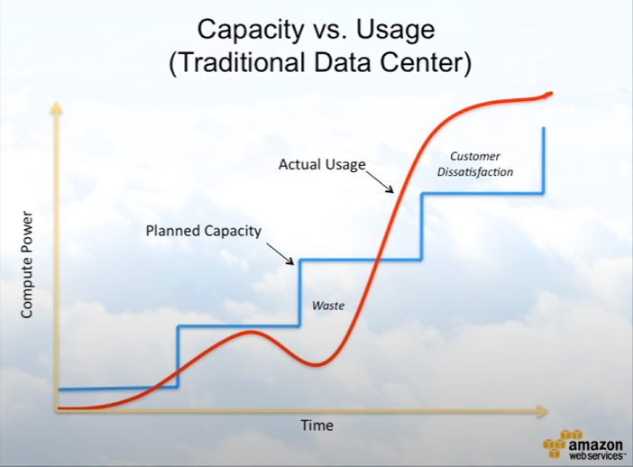
Cloud-Based Development Principles
Elasticity: Cloud services like AWS offer elasticity, allowing applications to scale resources up or down based on demand.
Pay-for-Use Model: Instead of upfront costs, cloud services operate on a pay-as-you-go model, ensuring you only pay for what you use.
Suggested image: An AWS graph depicting the correlation between capacity and actual usage, highlighting cost savings.
Notes:
Slide 4: Cloud-Based Development Principles
"Two principles stood out during our migration: Elasticity and the Pay-for-Use model. Elasticity ensured that as our user base grew, our resources scaled accordingly, without any manual intervention. The Pay-for-Use model, on the other hand, ensured cost-effectiveness. Instead of hefty upfront costs, we only paid for the resources we consumed. This graph here depicts our resource capacity versus actual usage, highlighting the cost savings we achieved."

Slide 5
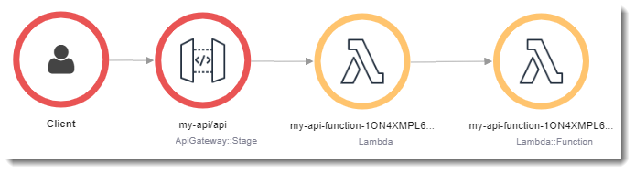
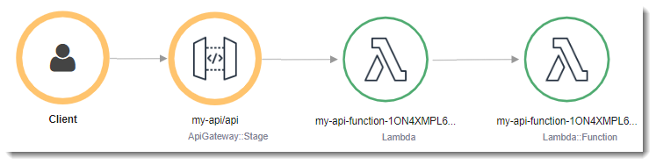
Securing Your Cloud Application
Unauthorized Access Prevention: Implementing robust authentication and authorization mechanisms using services like AWS Cognito.
Roles & Policies: AWS IAM roles define what actions can be performed on which resources. Policies are attached to roles to grant permissions.
Custom Policies: We created custom policies tailored to our application's specific needs, ensuring principle of least privilege.
Securing Connections: Ensuring encrypted connections between Lambda and API Gateway, Lambda and the database, and securing S3 buckets.
Suggested images: Diagrams showcasing security layers and flow of data with encryption.
Notes:
Slide 5: Securing Your Cloud Application
"With great power comes great responsibility. As we harnessed the power of the cloud, we also had to ensure our application was secure. We implemented robust authentication mechanisms, defined clear roles and policies, and ensured encrypted connections throughout our architecture. Whether it was the connection between Lambda and API Gateway or between Lambda and our database, security was always at the forefront. Here are some diagrams showcasing our multi-layered security approach."

Slide 6

Conclusion
1. Migrating to the cloud offers scalability, cost-effectiveness, and operational efficiency.
2. Proper planning, understanding of tools, and security considerations are crucial for successful migration.
3. Sharing these insights aims to assist fellow developers in their cloud migration journey.
Notes:
Slide 6: Conclusion
"In conclusion, our journey to the cloud was filled with challenges, but the outcomes made it all worth it. From scalability and cost-effectiveness to operational efficiency, the benefits were manifold. As I share our experiences today, I hope it paves the way for fellow developers, making their cloud migration journey smoother and more informed. Thank you for your time and attention."

